Slide 1
Lovable Presentation Template
This acts as your fundamental blueprint for creating engaging Lovable presentations. You're welcome to make adjustments while staying true to the essential principles outlined in the Lovable presentation style guide.

Slide 2
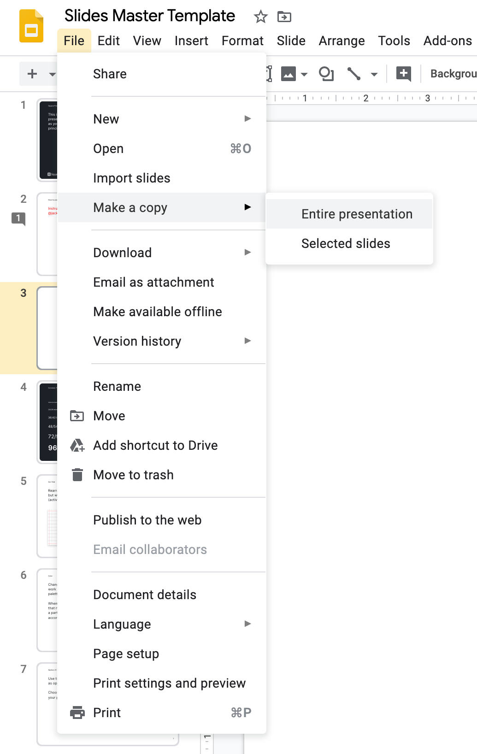
PLEASE DO NOT DESIGN OVER THIS TEMPLATE. DUPLICATE AND SAVE A COPY.
File -> Make a copy ->
Entire presentation

Slide 3
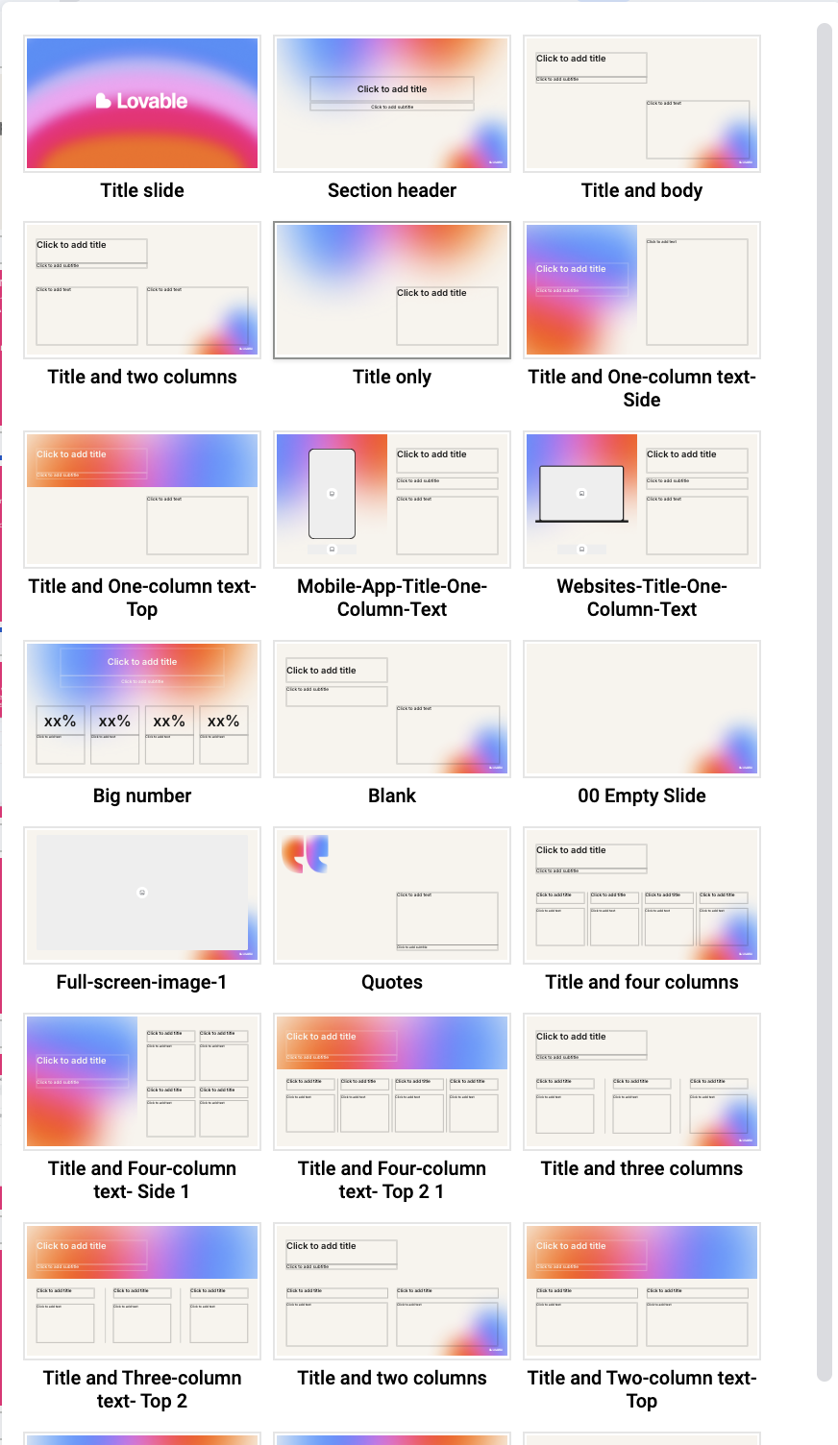
New Slides:
You can add new slides by clicking the “+” button at the top (available when your language setting is set to English [US]).
Alternatively, you can right-click on the slide panel and select “Apply layout” to explore all available template options for your presentation.
Please make sure to design within these predefined layouts to maintain the brand consistency of our deck templates.

Slide 4
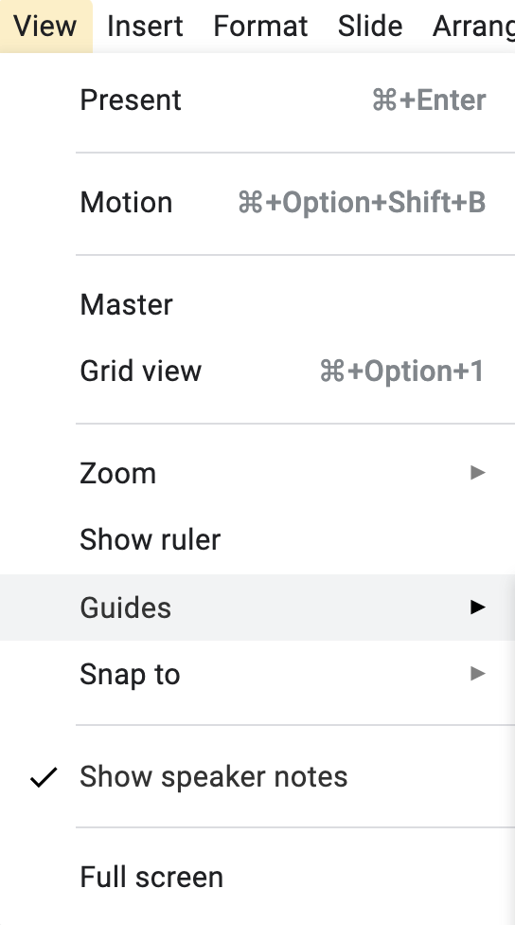
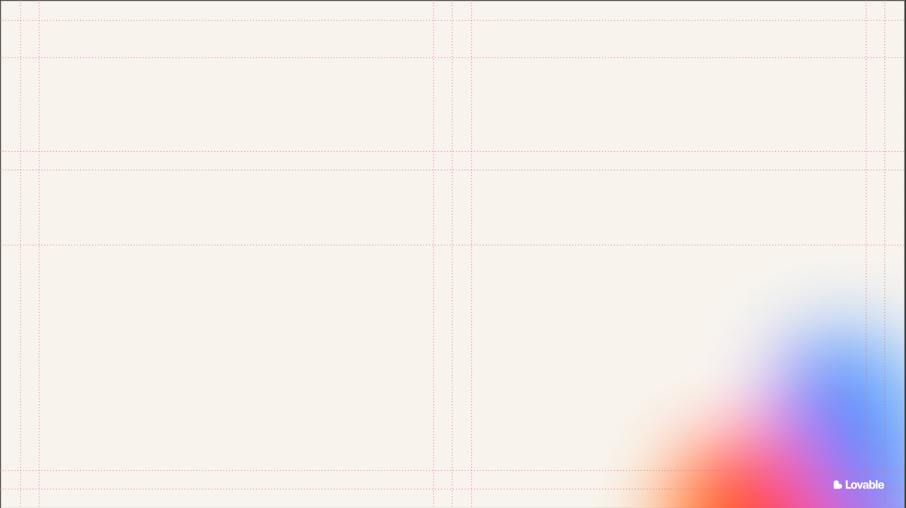
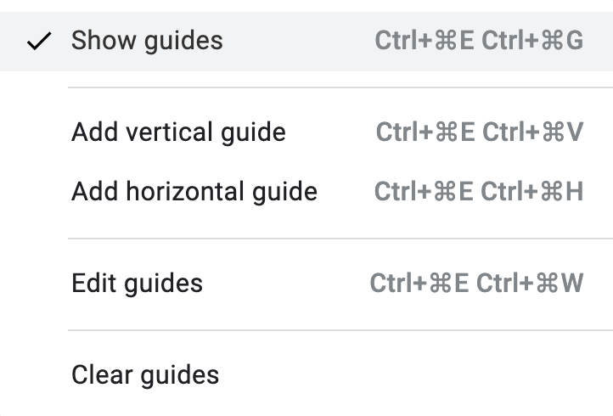
Guides:
Rearrange content as needed, but please work
within the provided guides. To activate the guides press Ctrl+⌘E + Ctrl+⌘G or select Show Guides in the menu.

Slide 5
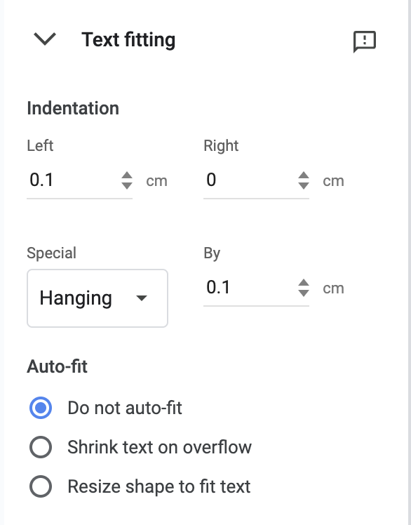
While creating Bulleted List:
Please follow this values shown here.

Slide 6
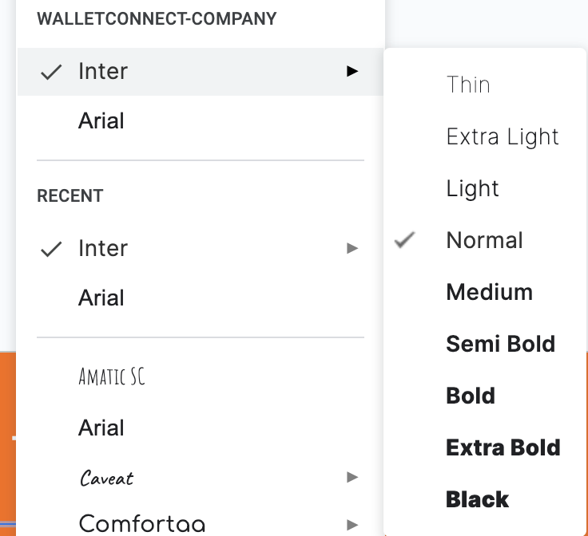
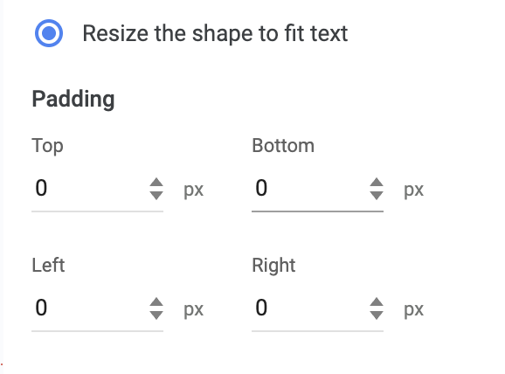
INTER is our Brand Google Font
Ensure that the Inter font is utilized, adhering to either the normal, medium or semibold weight. In exceptional circumstances, it is acceptable to employ other font weights.
Font Sizes
Headline- 28 PX
Subhead- 14 PX
Body copy- 10PX
If you’re adding additional textbox, always follow the below settings

Slide 7
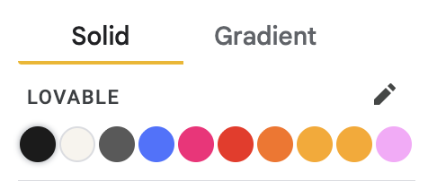
Colors
Adjust the color as required, while staying within the established color theme integrated into the document. When developing a presentation aligned with a partner company's brand, modify the colors accordingly.

Slide 8
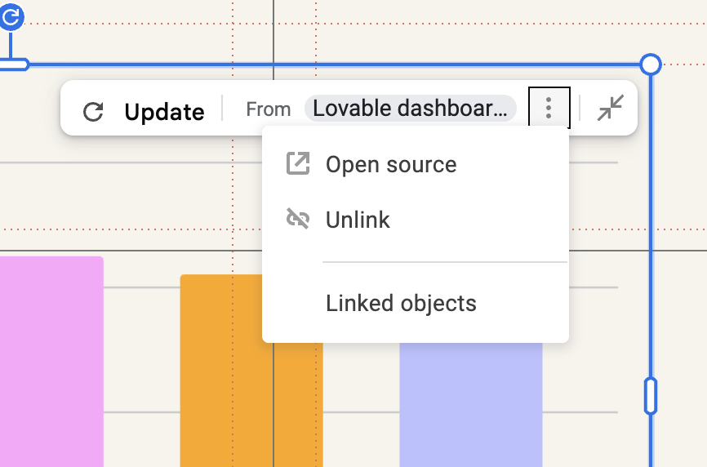
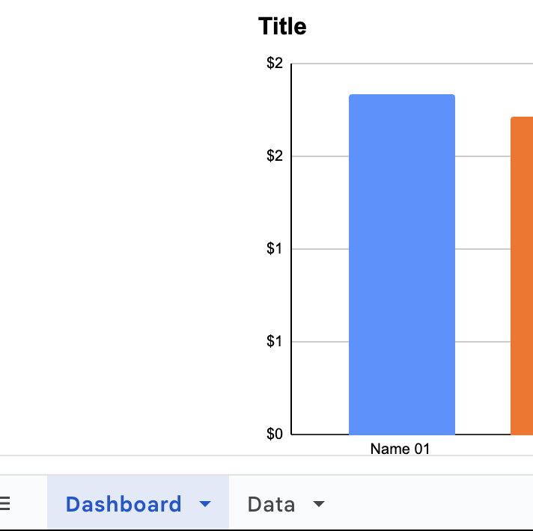
Graphs
Copy and paste the graphs into your preferred layout and adjust their size as needed.
To edit values or colors, click the three dots on the top-right corner of the graph and select “Open source.”
In the opened Google Sheet, go to the Data tab at the bottom and update the table values.
If the updated data doesn’t automatically reflect in the deck, copy and paste the graph again from the sheet.
To create multiple or alternate versions of graphs, duplicate the Google Sheet, make your edits, and then paste the new graph into the deck.

Slide 9
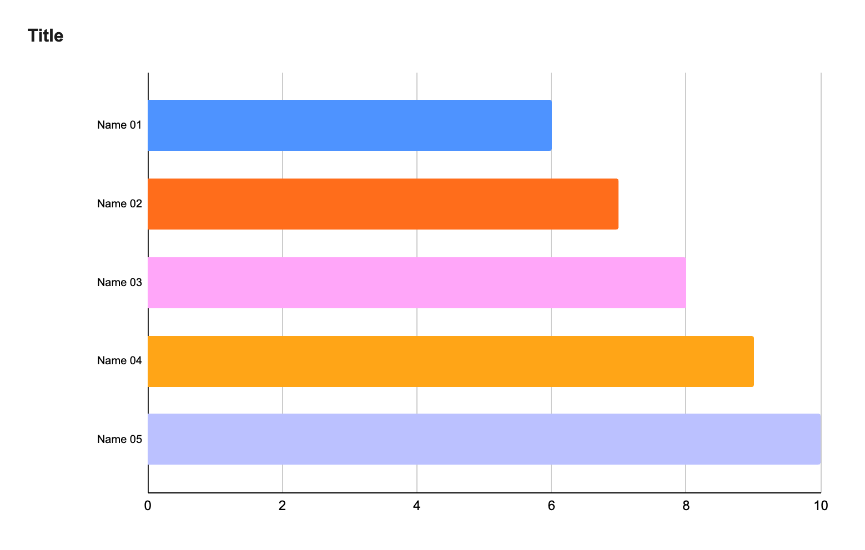

Slide 10
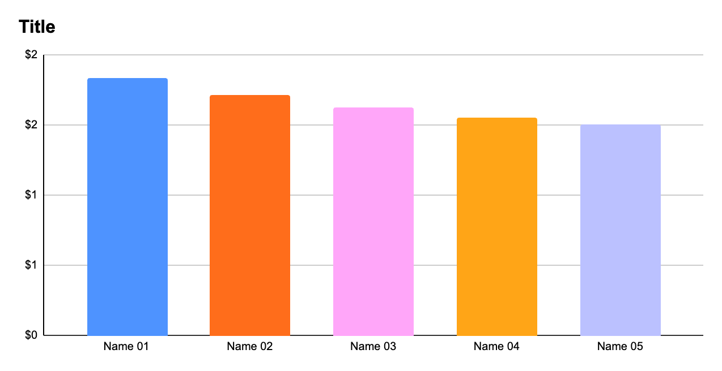

Slide 11
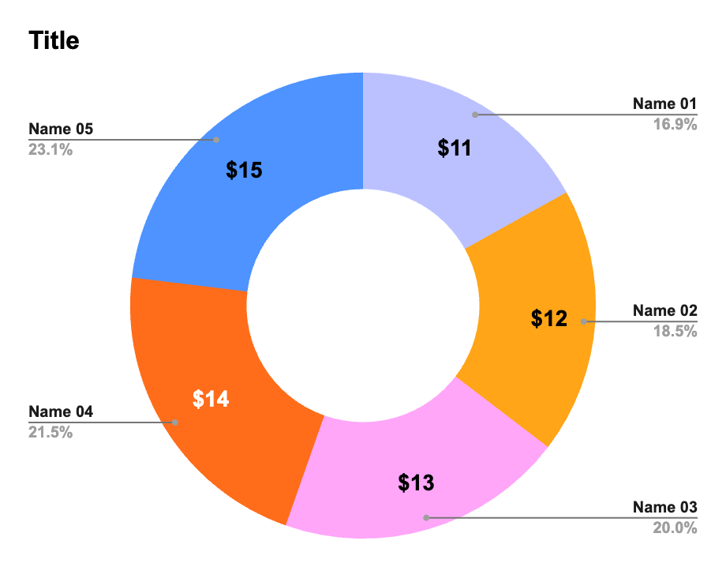

Slide 12
Any questions or concerns relating to presenting externally, please email abey@lovable.dev

